Slide 1


IT ENTREPRENEURSHIP PROJECT SPRING 2021
CITC 2335 System Analysis and Design
Team 1: Ketlin de Mello, Megan Farmer Spring 2021

Slide 2


Ketlin de Mello
I am currently studying Computer Information Technology with a concentration in Programming at Chattanooga State. In the last two years, since I started this new career, I have learned and used languages and frameworks like C#, .Net Framework, SQL, JavaScript, HTML, CSS, Python, Java, and GitHub. Outside school I work as a software developer and research intern at Oak Ridge National Laboratory.
Currently the CEO of Arcanum. I have been responsible for developing databases, from the design process until it’s deployment.

Slide 3
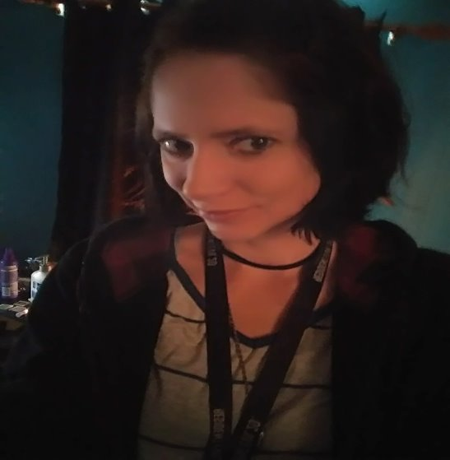
Megan Farmer
I am a student at Chattanooga State Community College and studying Computer Information Technology with a concentration in networking. I have had some experience working at the Help Desk and the Networking departments at Chattanooga State while studying. My experience includes jobs such as imaging computers, replacing hardware, setting up new computers in classrooms, deconstructing computer labs, setting up software programs such as AutoCAD and Maya, assembling a server rack, assisting connecting a patch panel, troubleshooting basic computer problems, and inventory.​​
I have been working with Arcanum since its creation and have been responsible for maintaining the hardware and the day-to-day network operations.

Slide 4
Team Members
Ketlin Team Leader
Megan Team Manager

Slide 5


Business Card

Slide 6


Teamwork
Ketlin
Video
Databases
Presentation
Vision, mission
Project Charter Plan
Organizational Chart
Project Management Timeline
Megan
Flyer
Folder
Website
Presentation
Swot Analysis
Excel Budget Sheet
Market Analysis

Slide 7
ePortfolio
Ketlin de Mello www.ketlindemello.com
Megan Farmer https://chattanoogastate.digication.com/megan-farmer1/home-1​

Slide 8
Individual Experiences
I Ketlin, found this project a great way to use and improve leadership, management and soft skills. The most interesting part about this of project is that it helps us to learn something new. I did not have much knowledge about databases before, but to be able to talk about, implement a code and produce ideas, I had to read, research, and learn how to work with databases using C#. After this project I have a better understanding of database manipulation.
During this whole process, I Megan worked on the Budget, Market Analysis, Website, Data Flow Diagram, Flyer, and Brochure. With each step of the process from step one to step four, we divided these processes and conquered them. If either of us had questions about what we were doing, we communicated as team to accomplish our goals.

Slide 9
Communication Tools
Microsoft
Gmail

Slide 10





Company Information
Arcanum identifies real opportunities and discovers what needs to be done. We believe great solutions come to life with the right digital strategy, along with the ability to prioritize, deliver, and measure the best user experience and technology.
The Database and Platform Management project has been created to provide comprehensive organizational database development and optimization to local business in the Chattanooga area.

Slide 11
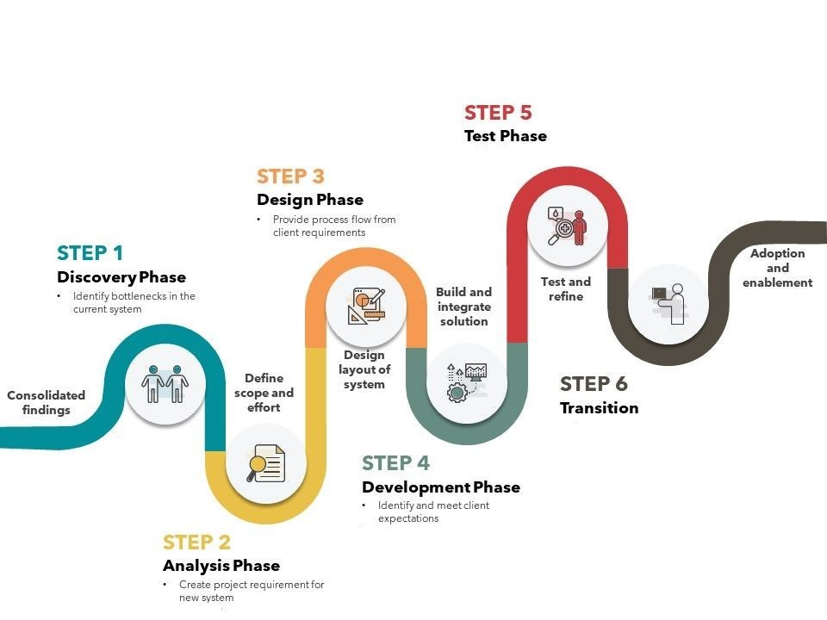

Slide 12
SWOT Analysis
WEAKNESSES
STRENGTHS
First local company offering face-to-face customer dedicated databases in the Chattanooga area.
OPPORTUNITIES
Possible opportunity to expand to neighboring areas in Tennessee Valley.
THREATS
Online presence of generic but faster ready to go databases systems.
Limited work capacity given number of software designers and developers.

Slide 13
Organization Chart
Ketlin C.E.O Software Developer
Megan General Manager Networking Analyst
Ruth Software Architect
Steven Software Developer
Lavonne Sales Consultant

Slide 14
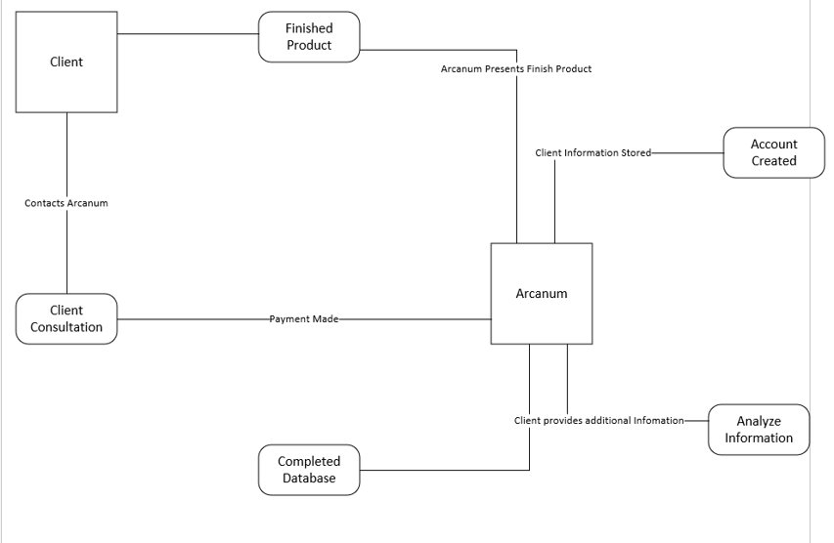
Data Flow Diagram

Slide 15





Mullis Annette Restaurant

Slide 16
Project Charter Plan
Project Title
786B Mullis Annette
Start Date
Mon 3/1/2021
End Date
Mon 7/26/2021
Scope
The project will include face-to-face business analysis, development, implementation, deployment and follow up with adaption and enablement.
Risks
$23.000
Relational database system may not be ideal for the client’s project.
Financial
Need
Need of centralize all the information for the business. Keep track of sales, inventory, promotions, budgets, personnel. Help schedule the most efficient shifts, ensure all staff are up to date on training, and see who is on track for promotion.
Product
Relational database built with MySQL, comprehending employee table, customer table, invoice table, vendors table, department, manager table, salaries table. User interface built in C#.
Premise

Slide 17
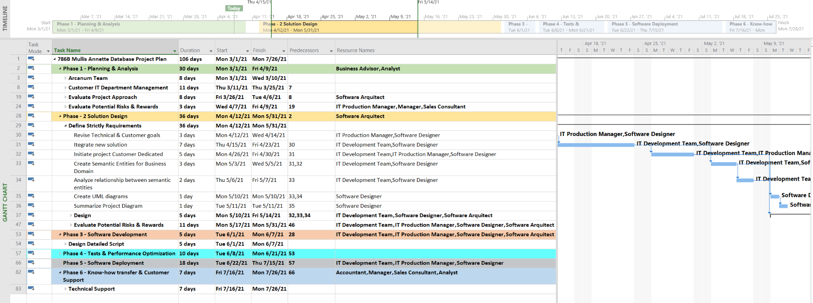
Project Management Timeline

Slide 18
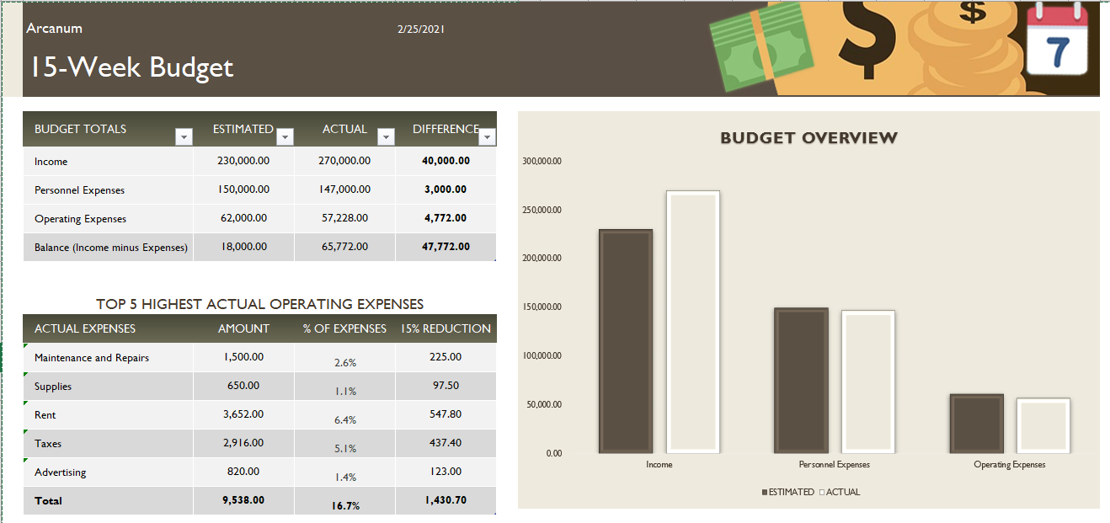
Excel Budget Sheet

Slide 19
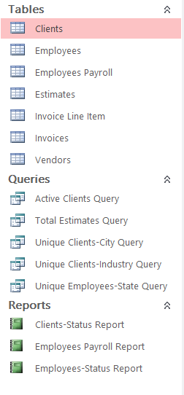
Database
Clients
ID | STATUS | COMPANY | CONTACT | PHONE NUMBER | ADDRESS | CITY | STATE | ZIP CODE | INDUSTRY | START DATE | END DATE
1 | ACTIVE | Mullis Annette | John McField | (423)374-389 | 1117 S. Congrees Parkway | Chattanooga | TN | 35127 | Food | 2/22/2021
2 | ACTIVE | River Valley | Lan Davis | (423)745-0323 | 725 Foster Court | Hixson | TN | 39177 | Finance | 2/25/2021
3 | ACTIVE | Random Reason | Macey Allen | (423)949-9330 | 7919 Madison St. | Hixson | TN | 39177 | Retail | 3/15/2021
4 | ACTIVE | Trinkets And Toys | Lesly Howell | (423)949-9330 | 8986 Center Dr. | Chattanooga | TN | 39263 | Entertainment | 1/25/2021 | 3/30/2021
5 | ACTIVE | Spideradio | Kareem Robbins | (423)-337-4085 | 231 Birchwood Street | Sweetwater | TN | 37596 | Telecommunications | 2/15/2021
6 | INACTIVE | Hammer Records | Sylvia Bryant | (731)845-1410 | 9142 Mountainview Rd. | Red Bank | TN | 32658 | Telecommunications | 3/15/2021
7 | ACTIVE | Signal Corp | Ashlynn Conrad | (430) 533-1706 | 387 Rockaway Ave. | Decatur | TN | 32795 | Health Care | 3/24/2021
8 | INACTIVE | Summitechnologies | Pablo Lyons | (804) 433-3038 | 15 Ocean Avenue | Chattanooga | TN | 32597 | Health Care | 3/25/2021
9 | ACTIVE | Pride Microsystems | Delaney Doyle | (884) 300-5981 | 8322 Old Pineknoll Court | Chattanooga | TN | 32795 | Technology | 3/26/2021 | 3/29/2021

Slide 20

Web Link
Video
Arcanum Website

Slide 21
Summary and Reflection
Opportunity: Database administrators’ resources are expensive and scarce. Arcanum provide cost-effective access to a deep pool of DBA expertise without hiring resources or assuming additional costs.
Mission: Successful database consulting takes more than just theoretical ideas; it takes practical experience. Arcanum yields superior results thanks to face-to-face business solutions, real-world industry, business, and use-case-specific experience. We align your database with strategic short-term and long-term business goals and then architect for optimal database performance using tested processes, platform migration, 24-hour support, database development and optimization.
Solution: Arcanum works alongside to company teams to help create and modify instances and databases based upon best practices and correctly sized every time.
Market focus: Enterprises performing software development in Chattanooga and surrounding cities.
Competitive advantage: Employee-owned business with established reputation in Chattanooga and surrounding cities offering face-to-face business solutions.
Ownership: 20% angel investor, 80% employee owned.
Expected returns: Once Arcanum reaches $500,000 profit within a two-year timeframe; we are going to extend our consulting services to Knoxville area.

Slide 22

Questions?

